Slide 1
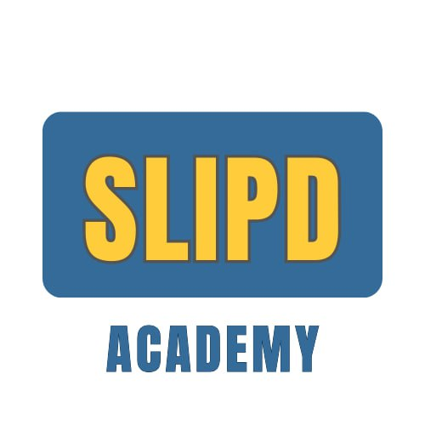

AI vs ML vs DL vs LLMs
They Are Not The Same — They Are Nested Subsets
Every Deep Learning model is Machine Learning.
Every ML model is AI. But not vice versa.
A lecture by Maneesha Rajapaksha

Slide 2
The Nested Relationship
🧠 AI
Artificial Intelligence
The broadest circle — any technique for intelligent behaviour
📊 ML
🔥 DL
Machine Learning
Learns rules from data, not hand-coded
💬 LLMs
Deep Learning
Neural networks with many layers, auto-learns features
Large Language Models
Transformer-based DL trained on massive text

Slide 3

Artificial Intelligence — The Biggest Circle
Any technique that enables a machine to simulate human-like intelligent behaviour — perceiving, reasoning, deciding, or acting.
AI Without Machine Learning
Rule-based expert systems
IF fever > 38°C AND cough → suspect pneumonia
Key Insight
Chess engines (Deep Blue)
Minimax search with alpha-beta pruning
AI is the goal.
ML and DL are just two different
strategies to reach that goal.
Pathfinding (A*, Dijkstra's)
Graph search algorithms
Symbolic reasoning (Prolog)
Logic-based knowledge representation
Core Question: Can a machine do this intelligent task?

Slide 4

Machine Learning — A Subset of AI
Instead of hand-coding rules, give the machine data + an objective — it learns the rules itself.
Model = Algorithm(Training Data) → Prediction = Model(New Input)
Supervised
Unsupervised
Reinforcement
Learn from labelled data
(input → output pairs)
Find hidden patterns
in unlabelled data
Learn by trial-and-error
with rewards
Spam detection,
disease diagnosis
Customer clustering,
anomaly detection
AlphaGo,
trading bots
Core Question: What patterns can the machine extract from this data?

Slide 5
Classic ML Algorithms (Not Deep Learning)
Linear Regression
Logistic Regression
Decision Trees
Random Forests
Support Vector Machines
K-Means Clustering
Naive Bayes
K-Nearest Neighbors
Gradient Boosting
⚡ Limitation: These work well on structured/tabular data but struggle with raw images, audio, or text — you need manual feature engineering. That limitation is exactly what Deep Learning solves.

Slide 6

Deep Learning — A Subset of ML
Neural networks with many layers that automatically learn hierarchical features — no manual feature engineering.
Raw Input
→
Layer 1
(edges)
→
Layer 2
(shapes)
→
Layer N
(objects)
→
Output
Example: CNN on X-ray
Key Architectures
Layer 1 → Edges and textures
CNNs Images, radiology, pathology
Layer 3 → Shapes (ribs, lung borders)
RNNs / LSTMs Time series, early NLP
Layer 8 → Pathological patterns
Transformers Text, images, audio (dominant)
GANs / Diffusion Image generation
Core Question: What can neural networks learn if we make them bigger and train on more data?

Slide 7

LLMs — A Subset of Deep Learning
Transformer-based deep learning models trained on massive text corpora to predict the next token.
Text Corpus
(trillions of tokens)
→
Transformer
(attention layers)
→
Base LLM
→
RLHF
→
Aligned LLM
(GPT-4, Claude)
What Makes Them "Large"
Billions+ Parameters — massive neural networks with hundreds of billions of weights
Trillions Tokens — trained on essentially all text ever written on the internet
Emergent Capabilities — abilities not present in smaller models (reasoning, code, etc.)
The current frontier of DL applied to language — GPT-4, Claude, Gemini, LLaMA

Slide 8

How They All Relate — Comparison
 | 🧠 AI | 📊 ML | 🔥 DL | 💬 LLM
Is subset of | Nothing | AI | ML | DL
Core mechanism | Rules or learning | Statistical optimisation | Backprop through layers | Transformer + tokens
Needs data? | Not always | Yes | Yes (lots) | Yes (massive)
Learns features? | No | Partially | Yes (automatic) | Yes (language)
Example | Expert systems | Random Forest | ResNet, AlexNet | GPT-4, Claude
Peak era | 1950s–80s | 1990s–2000s | 2012–2017 | 2020–present

Slide 9
The One-Line Answer
🧠 AI is the destination
📊 ML is one road to get there
🔥 Deep Learning is a powerful vehicle on that road
💬 LLMs are the latest model of that vehicle, tuned for language
Every DL is ML. Every ML is AI. But not vice versa.

